Slide 1

Business Plan For Money Lending Business In Malaysia
11.03.2016

Slide 2
Table Of Contents
1 | Investment Summary | 3-5
2 | Market Overview | 6-10
3 | Legal Setup | 11-16
4 | Product & Marketing | 17-34
5 | Decision Making & Collection | 35-44
6 | IT | 45-48
7 | HR & Admin Information | 49-51
8 | Finance | 52-59
9 | Project Risks & Mitigation | 60-62
10 | Project Plan | 63-64
11 | Appendices | 65-70

Slide 3
Investment Summary

Slide 4
Investment Summary
Malaysia Money Lending Market is one of the most promising markets in Asia due to these key factors:
High GDP per capita ($10.9K)
High average income per capita ($1.05K)
High bank account penetration (70%)
Low- tech and unconsolidated Loan Sharks and pawnshops are active in covering large untapped and growing unbanked market
Money lending market regulation not tough compared to other AP markets (easy process for getting license, minimum restrictions for advertising).
Malaysia’s household debt-to-gross domestic product (GDP) ratio is 146 per cent. With high debt ratios, the commitment of borrowers (individual commitment includes client’s existing mortgages, car loans, credit card debts, personal loans with the banks) prevents them from getting loan approvals easily with banks.
Key success factors in the market:
Product - new convenient product with fixed interest rate to replace Loan Shark offers (with low loyalty).
Technology – modern technology will allow customers to easily apply for a loan (via online application, mobile application, Facebook application) and receive loan amount (and repay it) via their bank account or at offline offices.
Advertising – new innovative tools of online advertising will allow us to reduce customer acquisition cost (to $24).
We believe that MY market environment positions us for achieving success within a short time frame

Slide 5
Investment summary
Investment summary |  |  | Timeline
thsd USD | Year 1 | Year 2 | Year 3 | Year 4 | Year 5* | Total
investments | 4 639 | 3 674 | 249 | 0 | 0 | 8 563
Total investments | 4 639 | 3 674 | 249 | 0 | 0 | 8 563
Number of loans issued (thsd) | 9 | 47 | 89 | 141 | 198 | 483
Amount disbursed | 3 661 | 20 510 | 41 989 | 68 739 | 98 463 | 233 361
Net portfolio (EoY) | 1 160 | 3 529 | 6 114 | 9 813 | 13 503 | 13 503
Revenue | 700 | 7 059 | 15 496 | 25 452 | 37 314 | 86 021
One-off expenses | -567 | 0 | 0 | 0 | 0 | -567
Net profit after taxes | -2 907 | -1 171 | 3 705 | 6 774 | 11 440 | 17 840
ROE (yearly) | -113% | -17% | 41% | 75% | 126% | 51%
ROAA (yearly) | -261% | -34% | 60% | 69% | 81% | 42%
* - normalized year with no new clients growth
Break-even period – 18 months.
Payback period – 51 months.
Maximum investments from – $8,6M.

Slide 6
2. Market Overview

Slide 7
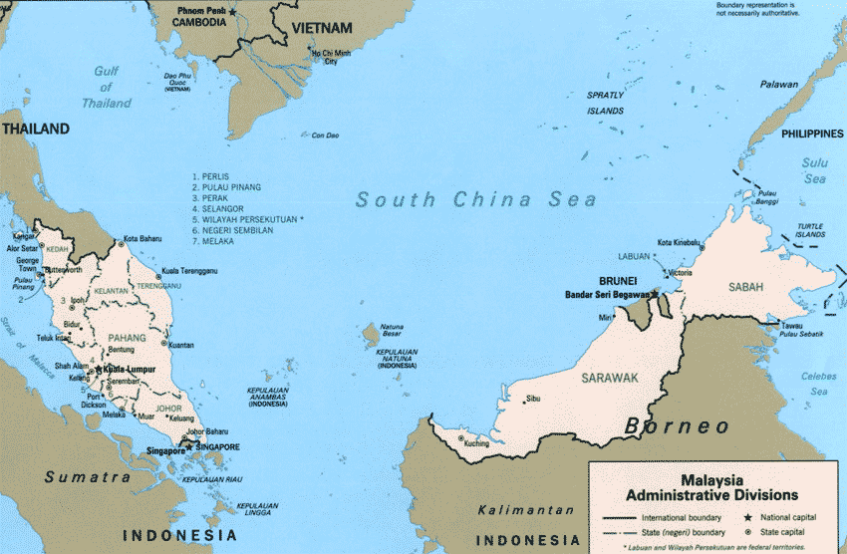
General Market Information
Population – 30.4 mln (2014)
In employment age – 20.9 mln
Labor force – 14.2 mln
Urban population – 70%
Official languages – Malay & English
Average monthly income – $1.05K (2014)
GDP Per Capita (Nominal) – $10.9K (2014).
Household debt-to-GDP ratio – 146% (2015).
Household unsecured debt-to-GDP ratio – 80.5% (2014)
Mobile phone penetration – 140% (2014)
Internet penetration – 67% (2015)
Smartphone penetration - 63%
Bank accounts penetration – 70% *
Debit card penetration – 63%
Credit card penetration – 12%
Online banking penetration – 58% **
Mobile banking penetration - 18.6%**
Electronic payment penetration – 13%***
Mobile payment penetration – 3%***
* source of information - http://www.bnm.gov.my/index.php?ch=en_speech&pg=en_speech_all&ac=512
** source of information - https://malaysiafinancialservices.wordpress.com/category/online-banking/
*** source of information - https://www.techinasia.com/is-southeast-asia-ready-for-online-payments/

Slide 8
Consumer Finance Industry Landscape
One of the oldest credit institution in Malaysia is the business of moneylending. It began in the 19th Century where the Malay States were attractive place for the living of the immigrants from India and China. (Lal Harcharan Singh, 2003). During the British era, the Indian Community has played important role in economic development of the Malay States in rubber tapping and mining. At the end of the 19th century and early middle of the 20th century, the Chettiar** were the sole lender to the Chinese farmer to grow paddy, small rubber tappers, government servant and Malays aristocrats. (Kratoska, 2013).
Consumer lending in Malaysia is performed by Banks, Licensed Moneylenders, Pawnshops and Finance companies (Credit Card companies). At the same time there is the big unregulated grey area which is estimated to have the largest share of short term unsecured loan market (including PDL).
In the last seven years since the US subprime crisis (by international research firm McKinsey Global Institute), Malaysia’s consumer debt was shown as having surpassed even that of the US. Latest data from the fourth quarter of 2014 showed that Malaysia’s household debt-to-gross domestic product (GDP) ratio is 146 per cent, an increase from 139 per cent during the same period in 2007.
Bank loans approval rate in 2015 is 41% vs 65% in 2007 respectively.
Bank Negara, the central bank of Malaysia, implemented new regulations in July 2013:
New loan tenures were set for personal loans at 10 years instead of 25 years while mortgages / housing loans are now allowed a maximum payback term of 35 years versus the previous 45 years. In addition, pre-approved personal financing products such as unsolicited loans were also banned. Consumers thus had to face a higher monthly repayment amount, forcing them to curb their reliance on retail lending.
Toughening Bank regulation moves credit demand to non-bank loans providers, offering increasing opportunities
* Data sources: http://www.bloombergtv.my/spike-august-2015s-loan-growth-malaysian-banks-sustainable/
** The term Chettiar or Chetty or "Shetty" is a title used by various mercantile castes in South India, especially in the states of Tamil Nadu and Kerala. In Tamil Nadu, 14% of the population is Chettiar

Slide 9
Licensing Options
Parameters | Bank | Credit Card Company | Moneylender | Pawnshop | Co-operative
Main purpose | Full-range banking services for retail and corporate clients | Lending activity with credit cards, deposit taken | Lending services for individual and corporate | Lending services with collateral | Lending services for members
Minimum paid-up capitalization | $500M | $75M | $500K | $750K | Unspecified
Max foreign capital share | 60% | 100% | 100% | 100% | 0%. All members must be citizens of MY
Possibility to sell retail credit products | Yes, including credit cards | Yes, including credit cards | Yes, excluding credit cards | Yes, excluding credit cards | Yes, excluding credit cards
Interest cap | 18% per annum for unsecured | 18% per annum for unsecured | 18% per annum for unsecured | 24% per annum | 18% per annum for unsecured
Regulator | Bank Negara | Bank Negara | Ministry of Housing and Local government | Ministry of Housing and Local government | Cooperative Commission of Malaysia
Term for getting license | NA | NA | 30-45 Days | 30-45 Days | NA
Number of active licenses | 43 (including Islamic) | 3 | More then 3000 | ~400 | ~12,000
Money Lending License offers the most opportunities with the widest range of possible uses:
In Line with our Business activities
Low minimum capitalization
Source: Solidiance Interview & Analysis

Slide 10
Market Size Estimation
Mln USD
 | 2016 | 2017 | 2018 | 2019 | 2020
Our disbursement volumes, mln. USD | 3.7 | 20.5 | 41.9 | 68.6 | 98.3
Our Number of loans (thousand) disbursed per year | 9 | 47 | 89 | 141 | 198
Main assumptions:
Official PDL Market is comparable with black market. The share of ML slowly increasing due to Government pressure on Grey Market
Yearly market size growth – as of 2017 - based on Solidiance report, for 2018-2020 - 9% as estimated by MY team
Our market share in 2020 is expected to be at 1.98%.
Source*: http://www.thestar.com.my/business/business-news/2015/11/11/loan-growth-may-shrink-further-in-2016/

Slide 11
3. Legal Setup

Slide 12
ML Regulation
Regulator:
Ministry Urban Wellbeing, Housing And Local Government
Document regulating Moneylending:
The Moneylender’s Act, 1951 ( Act 400 )
Anti-Money Laundering and Counter Financing of Terrorism (AML/CFT) – Money Services Business (Sector 3)
Personal Data Protection Act 2010
Mandatory documents for Moneylender:
The Moneylending License
Advertising permit
Regulation practice:
The Legislation is very strict, any breach of law in ML Act will result in monetary fine or prosecution or both
At the same time, the ML regulation is not the main focus of Ministry Of Urban Wellbeing And Local Government, the ML legislation is rarely updated to be in line with modern technology instruments. As an example, there are grey areas that exists between the ML Act and Electronic Signature Act.
The function of fighting against loan sharks was assigned to the police. For 2012-2014, more than 1000 of loan sharks were prosecuted and 50% of them were arrested.
We need to use Business model and Product both not violating strict regulation and fully utilizing advantages of grey areas
Notes:
Ответ от Rajah & Tan

Slide 13



Critical Business Model parameters 1/2
# | Parameters | Restrictions | Opportunities / Decision
1 | New licenses | Ongoing, no restrictions
2 | Product type | No restrictions for Payday Loans
3 | APR/EIR interest cap | Interest cap 18% per annum for unsecured loans. Only commissions allowed on top of interest rate: Stamp duties – fees charged by Taxation Authority to Validate the Loan Agreement. The amount - 2.5$. It’s not our commission. Legal costs incidental to or relating to the negotiations for or the granting of the loan. The cost is chargeable by any legal entity (external lawyers, in house counsels, legal consultations for loan process). Also to include cost to a 3rd party whilst processing the loan application including risk consultation. The amount - determined by this 3rd parties: Credit Bureau report – 2.1$. It’s not our commission. Attestation fee – 2.5$. It’s not our commission. Fees payable by law : there is no description in the Law | Legal costs incidental to or relating to the negotiations for or the granting of the loan: Fees that is payable by the moneylenders to a 3rd party whilst processing the loan application including risk consultation. This allows us to get target profitability: we will take commission payable to independent company which will do the clients assessment services (Due Diligence fee). Due Diligence fee – 20% from Loan Amount
4 | Advertising requirements | TV or Radio Adverts are restricted Internet, Press and BTL required special permit from Regulator
5 | Possibility to use and store clients data out of the country | Not required by Moneylending Act
There is probability to get target profitability by using fees allowed by law: we will take commission payable to independent company which will do the clients assessment services (social scoring)
No specific issues
Need to pay some attention, but no serious issues
There are some issues, which require serious attention.

Slide 14
Critical Business Model parameters 2/2
# | Parameters | Restrictions | Opportunities / Decision
6 | Necessity to obtain written customer consent for processing his personal data | Not mandatory (can be done on a website or mobile application)
7 | Face-to-face customer’s verification (KYC procedure) | Not required by Moneylending Act. Regulated by Anti-Money Laundering and Counter Financing of Terrorism (AML/CFT) “Reporting institutions shall not undertake any transactions without face-to-face contact with the customer unless the business relationship with the customer has been first established and CDD measures have been conducted” | 1st loan agreement signing – face-to-face with courier Repeat loans – fully online
8 | Remote contract signing | Moneylending Act 1951 required agreement to be in writing | In 1997 acc to Digital Signature Act 1997 possibility of electronic signature appeared Electronic Commerce Act 2006 allows “electronic signature” means … sound or any other symbol … created in an electronic form adopted by a person as a signature”
 | Late payment | Calculated at the rate of 8 per centum per annum from day to day from the date of default in payment of the sum or instalment until that sum or instalment is paid | We will take commission payable to independent company which will charge an additional of 1% of the overdue amount per day as Debt Collection & Consultation fees.
9 | Debt collection | No specific restrictions
Due to existing legislation it is reasonable to sign initial agreement in writing (O2O model) with courier and make repeat loans fully online using customers consent during signing the initial loan agreement by customer
No specific issues
Need to pay some attention, but no serious issues
There are some issues, which require serious attention.

Slide 15
Legal setup
SG
Equity participation
Link
Paid-up capital
MM
APV
MY
100%
$125K
100%
$500K
2 Independent local directors:
1 – Head of Risk
1 – Nominee
Ace Risk Consultancy (Risk Management Company)
Ringgit Direct (Moneylender License owner)
2 Independent local directors:
1 – CEO
1 – Nominee
Service agreement
There should not be any visible relations between the shareholders of MFI and Risk Management Company (RMC) to provide opportunity for extracting additional profit with minimal legal risks
Each company should have at least 2 Directors, citizens of Malaysia:
Ringgit Direct Sdn Bhd (Moneylender License owner):
Mr. Geoffrey Looi (CEO under the Employment of ML)
Mr. Jeffrey Kong (Nominee only, not an employee)
Ace Risk Consultancy Sdn Bhd (RMC):
Mr. Harold Chen (Head of Risk under the Employment of RMC)
Ms. Shany Chang (Nominee only, not an employee)
Notes:
Ответ от Rajah & Tan

Slide 16
Process of Obtaining the Mandatory documents
Step | Description | Time | Status
1 | Establish a private limited company with 2 local directors, registered with the companies commission of Malaysia Company must have a physical operating address in the country | 7 – 14 working days | Done
2 | Cover Letter stating intention to apply for a license Cover letter must be signed by the Directors of the company | 15 working days | Done
3 | Complete necessary forms New application Licence Statutory Declaration
 |  |  | Done
4 | Company Directors to submit personal identification for approval (Passport) |  | Done
5 | Submit company credentials |  | Done
6 | Company must have a minimum paid up capital of RM 2,000,000 ($500K) in the bank account. We should retain this sum of money in the company’s bank account for about 2 weeks, and after that, the sum can be withdrawn from the company bank account. Must be supported by bank statements as proof. |  | Done
7 | Company or the Directors submitted must not have a pawnshop registered with them Money Lending businesses cannot establish or already have a Pawnshop licence.* |  | Done
8 | All needed documents are provided to the Regulator. Waiting for the Decision | 30 days | Target date 30.03.2016
9 | Special Permit for Advertising Application can only be made once the Money Lender license is approved | 30 days | Target date 30.04.2016
* Moneylenders Act 1951, Point №7 application of Licensing. – appendix, page 84
Notes:
Ответ от Rajah & Tan

Slide 17
4. Product & Marketing

Slide 18
Consumer Lending Landscape
Type | Annualized EIR | Loan Amount | Tenure | Verification | Time-to-Money | Target Customers
Unofficial lender | Up to 380% | $250 – $2 500 | From 1 week up to 6 months | ID, Salary proof, Address proof Field visit | Up to 3 days | Customers with unofficial salaries, no documentations, in black lists, no age limit
Licensed Moneylender | 18% legally, up to 318% illegally | $250 – $2 500 | Up to 12 months | ID, Salary proof, Address proof Credit Bureau check Phone verification | 60 minutes – 3 days | Customers without good credit history and overdebted
Pawnshop | Up to 24% | $250 – $10 000 | From 1 week up to 6 months | ID, Collateral | Up to 3 days | Customers with unofficial salaries, not complete documents, in black lists, no age limit, collateral
Co-operative | Up to 15% | $250 – $60 000 | Up to 25 years | ID, Salary proof, Address proof Credit Bureau check Phone verification | Up to 10 days | Only for government employees
Credit card company | Up to 18% | $250 – $60 000 | Up to 2 years | ID, Salary proof, Address proof Credit Bureau check Phone verification | Up to 5 days | Fresh graduates and young adults whom newly joined the workforce
Bank | Up to 18% | Up to $60 000 | 12-60 months | ID, Salary proof, Address proof Credit Bureau check Phone verification Guarantor (if required) | Up to 10 working days | Only for customers that have good to strong credit history
Our Target audience is customers without good credit history and overdebted + customers eligible for Banks, Cooperatives and Credit card companies but in urgent need of funds
* Description of competitors – Appendices page 74

Slide 19
Current ML Industry Business Models
 | Remote | Branch
Fully online* | Application on website Documents delivered via email, whatsapp, uploading during application Contract signing by confirmation with code sent via SMS Loan disbursed to client’s bank account | Not available
Online to offline | Application on website Documents delivered via email, whatsapp, uploading during application Couriers deliver contract for signing Loan disbursed to client’s bank account | Application on website Documents delivered by client to ML branch Contract signing physically in ML branch Loan transferring to clients bank account / by cash in ML branch
Fully offline | Not available | Application applying in branch Documents deliver by client to ML branch Contract signing physically in ML branch Loan transferring to clients bank account / by cash in ML branch
Fully online model is in grey area due to gaps between Moneylending Act 1951 and Electronic Commerce Act 2006
Most players are using mix business models: application could be on website or at the branch, Contract could be delivered by courier or contract could be signed at the branch
We know only one player in this market and his practice is illegal https://www.money2loans.com/

Slide 20

Online Loan Shark: Money 2 Loans
General Information | Established | 2011
 | Location | Malaysia (Kedah)
 | Owned by | TBD
 | Type of Business | Money 2 Loans have 3 different products: i) Personal Loans (medium term loans). ii) Payday Loans (short term loans). iii) Foreigner loans (short term loans)
History | Products & Processes
Established in 2011 Money2Loans is a online lending company in Malaysia.
No Moneylender license
Company is located outside Kuala Lumpur at Kedah
No branches
Clients: Citizens, Foreigners
Business model: Fully online
Minimum Borrower’s Income :
500 USD /month (Gross)
Features:
No Collateral
Time-To-Money: 3 hours
Disbursement channel – Cash deposit on account via ATM
Repayment channels: Cash deposit on account via ATM
Loan amount available :
up to 750 USD for Personal Loans for Income less than 400 USD per month
Not limited for Personal Loans for Income more than 2500 USD per month
Loan Period : Up to 6 months
Interest rate: 18% per annum
Illegal fees:
Up-front fee: Establishment fee is 25% of the borrowed amount
Effective interest rate: 258%
* Look appendix Mystery Shopping Online Lending Platform

Slide 21

O2O Money Lender: Potential Credit and Leasing
General Information | Established | 1985
 | Location | Malaysia (Kuala Lumpur)
 | Owned by | TBD
 | Type of Business | Potential Credit has 3 different products: i) Personal Loans (medium term loans). ii) Payday Loans (short term loans). iii) Foreigner loans (short term loans)
History | Products & Processes
Established in 1985
Licensed money lender
Company is located in Kuala Lumpur
1 branch
Sales per month
1 200 loans
Clients: Citizens, Foreigners
Business model: Online to offline
Minimum Borrower’s Income :
500 USD /month (Gross)
Features:
No Collateral
Time-To-Money:
O2O – 24 hours
Offline - 45 - 60 minutes
Disbursement channel – Cash on hand, Cash deposit on ATM account
Few repayment channels: cash, bank transfer
Loan amount available :
250 USD to 2,500 USD for Personal Loans
250 USD to 750 USD for Payday Loans
Loan Period : Up to 12 months
Interest rate: 18% per annum
Illegal fees:
Up-front fee: Establishment fee is 25% of the borrowed amount
Late payment fee: 10% from overdue loan amount
Effective interest rate: 318%

Slide 22

Offline Money Lender: Infinity Organization Solution
General Information | Established | TBD
 | Location | Malaysia (Kuala Lumpur)
 | Owned by | TBD
 | Type of Business | JCL has 3 different products. i) Personal Loan (medium term loans). ii) Business Loans (medium term loans) under the name of the corp. iii) Hire Purchase
History | Products & Processes
Infinity Organization Solution is a financing company that provides hire purchase as well as personal financing.
They also provide financial consulting catering to those who have been blacklisted because of a history of bad credit
3 branches in KL and Selangor
Sales per month
1 500 loans
Clients: Citizens
Business model: Online to offline
Minimum Borrower’s Income :
400 USD /month (Gross)
Features:
No Collateral
Time-To-Money:
O2O – 1-3 days
Offline - 1-3 days
Auto debit form obligatory
Disbursement channel – Bank account
Repayment channels: Direct Debit, Cash
Loan amount available :
250 USD to 750 USD for Personal Loans
Loan Period : Up to 60 months
Interest rate: 18% per annum
Illegal fees:
Up-front fee: Procсessing fee is 20% of the borrowed amount
Effective interest rate: 258%

Slide 23

Offline Money Lender: JCL Credit Leasing
General Information | Established | 1996
 | Location | Malaysia (Kuala Lumpur)
 | Owned by | TBD
 | Type of Business | JCL has 3 different products. i) Personal Loan (medium term loans). ii) Business Loans (medium term loans) under the name of the corp. iii) Hire Purchase
History | Products & Processes
Established in 1996, JCL is a credit company that has recently diversified into personal loans and corporate loans
1 main office in KL
Clients: Citizens
Business model: Online to offline
Minimum Borrower’s Income: 400 USD /month (Gross)
Features:
No Collateral
Time-To-Money:
O2O – 1-3 days
Offline - 1-3 days
Disbursement channel – Bank transfer
Repayment channels: Bank transfer
Loan amount available : 125 USD to 12 500 USD for Personal Loans
Loan Period : From 12 to 60 months
Interest rate: 18% per annum
Fees:
Stamp duty – 0.5% from the Loan Amount
Copy of Stamp duty – 2.5 USD
Legal (Attestation) fee – 3 USD
Illegal fees: 0
Effective interest rate: 18%

Slide 24
Our Strategy
# | Parameter | ML Product | LoanSharks | Our Offer
1 | Loan amount range | $250- $2500 | $250 – $2500 | $250 – $1250
2 | Average loan size | $1250 | $1250 | $400
3 | Average tenor | 3 months | 3 months | 25 days
5 | Upfront fees | 10%-25% (illegal) | 10%-35% (illegal) | 0
6 | Interest rate per year | 12%-18% | 120%-240% | 18%
7 | Effective IR rate per year | 52%-318% | 160%-380% | 365% (1% per day)
8 | Late fee | 25$-75$ per week (illegal) | No data | 1% per day
9 | Prolongation fee | No | No | No prolongation, repeat loan
10 | Time to money | 1 hour - 3 days | 3 hours – 3 days | 30 minutes – 1 day
11 | Loan disbursal | Cash in ML Office, Bank transfer, Cash by courier | Cash, Cash deposit on ATM account | Bank transfer
12 | Verification | ID, Salary proof, Address proof, Credit Bureau check Phone verification | ID, Salary proof, Address proof, Field visit | ID, Salary proof, Address proof, Credit Bureau check Phone verification, Bio scanner
13 | Business model | Online to offline / Offline | Online /Online to offline / Offline | Online to offline
Our strategy – we will focus on fast loan decision for reasonable loan amounts on low tenures

Slide 25






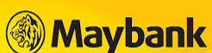


Initial Sales Business Process (O2O)
Application
Decision
Contract signing:
Loan granting
Functionality already available in Terrasoft and planned to be used
New functionality&Integrations to be implemented in Terrasoft
ID Checking
Approve Status SMS
GL
Autocount
Visual check, ID check with bio scanner by courier / in office
Collecting customer documents
Loan agreement signing by client
Inbound call
Outbound call
Terrasoft
Web site
General stop factors check
Meeting with courier appointment
Data checking (RMC)
Loan granting
Pre-Approval
Additional information required
Black lists & CCRIS check
Phone Verification (RMC)
Contract confirmation – sms / email
Transfer to customer’s bank account
Transfer to customer’s bank account
Online app
Reject
Customer
Reject
For Online Repeat sales
Reject Status SMS
Mobile App: Logistic
application
CTOS
Credit Background Check and in-house social score
Risk Management Company
25

Slide 26
Repeat Sales Business Process & Online
Functionality already available in Terrasoft and planned to be used
New functionality&Integrations to be implemented in Terrasoft
SMS campaign
Decision
Loan granting
Terrasoft
Outbound call
Searching customer in Pre-approved list
Approval
Approve Status
Contract confirmation
Inbound call
Social score check
Black lists & CCRIS check
Reject
Loan granting
Customer
Transfer to customer’s bank account
our current bank account
Transfer to customer’s bank account
CTOS
Credit Background Check and in-house social score
GL
Autocount
Risk Management Company

Slide 27
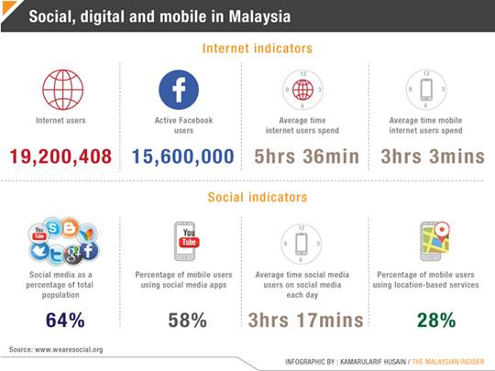
Malaysia digital marketing overview
Digital Market is well-developed with continuing growth
World’s popular players are highly presented in (Google, Facebook, Instagram, etc.).
We will use the same marketing strategies as in other APAC markets
*http://www.nielsen.com/my/en/top10s.html
**http://blog.malaysia-asia.my/2015/03/malaysia-social-media-statistics-2014.html
***https://www.statsmonkey.com/sunburst/18436-malaysia-search-engine-market-share-usage-statistics-2014.php
Notes:
При низком показателе проникновения кредитных продуктов, основная их часть сосредоточена в сегменте SEC A и SEC B, при высоких требованиях к заемщику. Стратегия DCFC – всегда доступная финансовая поддержка рядом с клиентом посзволяет ориентироваться на 70% рынка.

Slide 28
Online loans demand volumes. Devices
Stable volume of demand with seasonal peaks
57% of audience are 24+ years old
73% of audience are using mobile devices
Notes:
При низком показателе проникновения кредитных продуктов, основная их часть сосредоточена в сегменте SEC A и SEC B, при высоких требованиях к заемщику. Стратегия DCFC – всегда доступная финансовая поддержка рядом с клиентом посзволяет ориентироваться на 70% рынка.

Slide 29
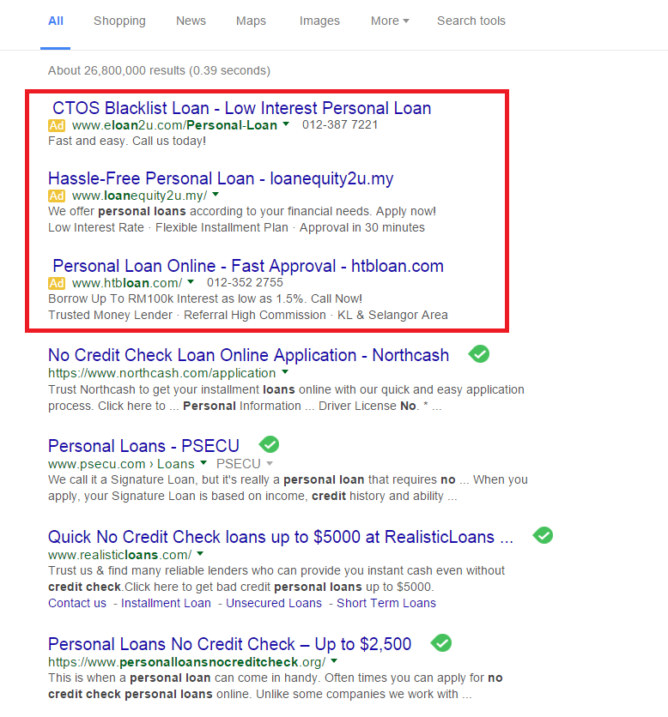
Online marketing toolkit: Google Search
Text Ad Targeting Opportunities:
Targeting is by keywords only.
Keywords need to relate to our site’s
content.
Other Opportunities:
• Language Targeting
• Location Targeting (Country, State, City)
• Devices
(Desktops/Laptops/Mobile/Tablets)
Category Targeting
• Generic Personal Loan Queries
• Brand Personal Loan Queries
• Competitor Personal Loan Queries
• Tactical – Fast Cash Queries
• Tactical – Emergency Cash Queries
• Association – Travel/Holidays
• Association – Health
• Association - Home Loans
Notes:
При низком показателе проникновения кредитных продуктов, основная их часть сосредоточена в сегменте SEC A и SEC B, при высоких требованиях к заемщику. Стратегия DCFC – всегда доступная финансовая поддержка рядом с клиентом посзволяет ориентироваться на 70% рынка.

Slide 30
Online marketing toolkit: Google Display
Text & Banner Ad Targeting Opportunities
Audiences on the Google Display Network
are targeted using:
• Keywords
• Topics
• Interests
• Age
• Gender
• Devices
• Language
• Location (Country, State, City)
Category Targeting
• Finance
• Travel
• Health
• Loan Specific
• Competitor Specific
Notes:
При низком показателе проникновения кредитных продуктов, основная их часть сосредоточена в сегменте SEC A и SEC B, при высоких требованиях к заемщику. Стратегия DCFC – всегда доступная финансовая поддержка рядом с клиентом посзволяет ориентироваться на 70% рынка.

Slide 31
Online marketing toolkit: Google Mobile
Text & Banner Ad Targeting Opportunities
Audiences on Mobile Apps are targeted using:
• Topics
• Interests
• Age
• Gender
• Devices
(Desktops/Laptops/Mobile/Tablets)
• Language
• Location (Country, State, City)
Category Targeting
• Finance
• Travel
• Weather
Opportunities:
Give consumers the ability to communicate
with the call center immediately or click on
the ad to visit the sign up page.
Targeting
• Google Search
– Keyword selection similar to Google
Search targeting approach.
Notes:
При низком показателе проникновения кредитных продуктов, основная их часть сосредоточена в сегменте SEC A и SEC B, при высоких требованиях к заемщику. Стратегия DCFC – всегда доступная финансовая поддержка рядом с клиентом посзволяет ориентироваться на 70% рынка.

Slide 32
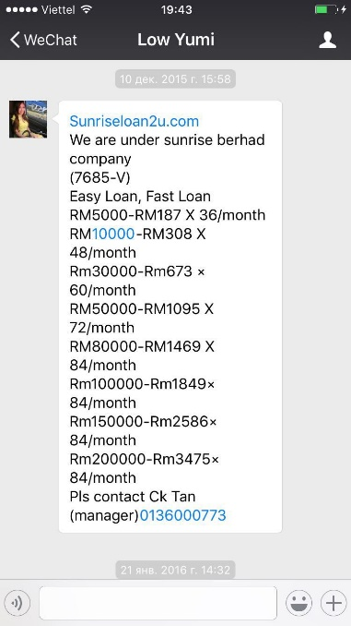
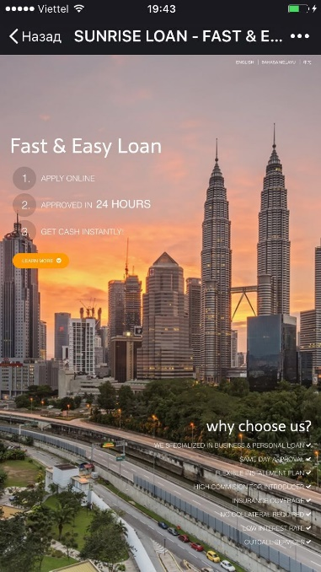

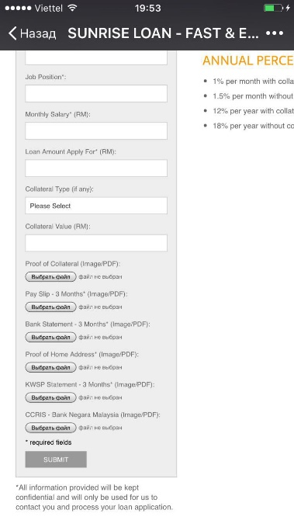
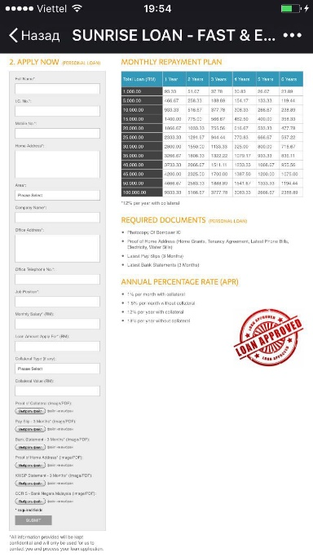
Social Media Advertising case
Client gets advertising message with the hyperlink
Client open the link
Offers details
Short application form…
…with product parameters and documents required
Client approve the request
Request to add as a friend from bot with the picture of nice lady
Notes:
При низком показателе проникновения кредитных продуктов, основная их часть сосредоточена в сегменте SEC A и SEC B, при высоких требованиях к заемщику. Стратегия DCFC – всегда доступная финансовая поддержка рядом с клиентом посзволяет ориентироваться на 70% рынка.

Slide 33
Marketing Mix & Marketing cost
# | Marketing tools* | Sales volume % | Lead cost $ | Approval rate % | Disbursement rate % | Client cost $
1 | Google Search Ad | 30% | $25 | 60% | 90% | $46
2 | Display Network | 20% | $10 | 60% | 90% | $19
3 | Google Remarketing** | 10% | $15 | 60% | 90% | $28
4 | Social Media*** | 40% | $4 | 60% | 90% | $7
 | Total | 100% | $13 |  |  | $24
The assumptions based on data provided by our marketing consultant Iprospect, the biggest Google’s client
During the first months we will manage our Marketing mix to achieve the optimal cost per client based on our digital marketing experience in Philippines and Indonesia
* Will be managed by in-house Digital Marketing Manager
** Remarketing lets you show ads to people who have visited your website or used your mobile app before. When people leave website remarketing helps you reconnect with them by showing relevant ads as they browse the web, as they use mobile apps, or as they search on Google
*** FB, WhatsApp, WeChat, Instagram, Twitter, etc

Slide 34
Sales Plan
Short term sales plan
 | May-16 | Jun-16 | July-16 | Aug-16 | Sep-16 | Oct-16
Number of loans disbursed per month | 100 | 300 | 600 | 900 | 1200 | 1500
Long term sales plan
Parameter | EOY 1* | EOY 2 | EOY 3 | EOY 4 | EOY 5
Number of loans disbursed per month | 2300 | 5400 | 9000 | 14000 | 18000
Number of New loans disbursed per month | 2100 | 3500 | 5000 | 7500 | 9000
Online advertising | 80% | 75% | 67% | 65% | 60%
Recommendations / Referrals | 7% | 9% | 13% | 14% | 15%
Repeat sales | 10% | 13% | 16% | 17% | 21%
Sms | 3% | 3% | 4% | 4% | 4%
* 2016 year

Slide 35
5. Decision Making & Collection

Slide 36
Risk Management & Collection Strategy
# | Parameters | Restrictions | Opportunities | Decision / Instruments
1 | Identification | Face-to-Face for the first loan (AML/CFT) | Mobile Biometric Scanner let to identify the client Electronic Commerce Act 2006 | NRIC mandatory Courier with biometric scanner Courier signs with customer consent for repeat loans without signature in-written
2 | Proof of Income | 30% of population have unofficial income | Bank accounts penetration – 70% Employee Provident Fund statement (EPF) penetration – 66% | Mandatory documents: bank statement or EPF
3 | Address proof | Market practice for low-income clients: No registration at temporary address Subleasing of living place | Registration address is in ID card (NRIC) White collars usually have Tenancy agreement or Utility bills for temporary | Mandatory documents: 3 months latest Utility bills or Tenancy agreement with minimum 3 months validity
4 | Credit History Check | 29% of population in working age records in CB ML not obliged to report delinquencies to CB | 4 CB available in the market 1 of 4 CB have extended data: Utility bills delinquency Nominals of bankrupt companies | Will be using CB CTOS as they report the most comprehensive data than compared to other CB (the largest number of records)
5 | Social Scoring applicability | No restrictions | Internet penetration – 67% Social media penetration – 67% Ave time internet user spend per day – >5h | We will verify customers profile in FB, Google and WhatsApp
6 | Collection | ML Act 1951: harassment or intimidation is strictly prohibited. Punishment - Fine, imprisonment No clear determination | Direct Debit is applicable Courts will take electronic contract and voices as evidence of contract signing | We will sign Direct Debit form with Customer together with Loan agreement We will use audio and video record of Collection actions
7 | Litigation / Execution | Markets practice is after 90 dpd | Court can issue warrant to fix the method of payment If customer doesn’t pay according to warrant – premise or moveable property could be arrested or client could be jailed | We will hire Legal council with the court cases practice. Min amount is not determined by Law. We will file by batches more than 2500$
Based on Market Restrictions & Opportunities we will use O2O model for initial sales. Developed infrastructure gives us reason to expect relatively low Cost of Risk

Slide 37
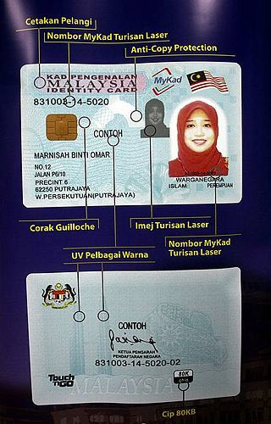
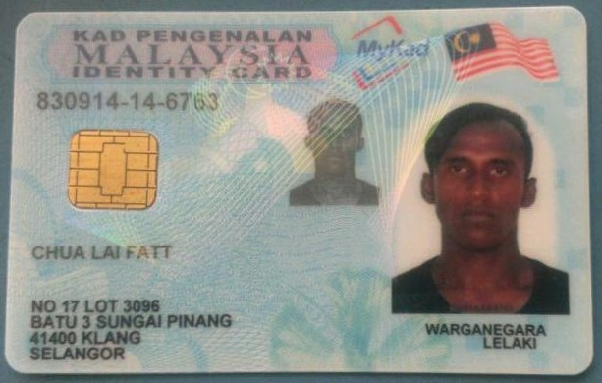
TOOLS: ID Card. Documents for Verification
National Registration Identity Card (NRIC*)
Coverage - NRIC covers 100% of citizens
Purpose – Clients’ Identification
Cost of obtaining the fake – 800 – 2000 USD
Features – cheap incorporated
Availability – 100%, in possession with clients all the time
Always available, highly protected, cost of obtaining the fake is higher than target loan amount
Hologram Printing
Laser etched printing ID Number
Anti-Copy Protection
INFORMATION ON ID CARD :
Guilloche Pattern
Laser etched Image
ID Number
[Birthdate (YYMMDD) – State – Unique ID Number]
Laser printing ID Number
Multi-color UV Printing
Name
Citizenship
Registered
Address
80K Chip Logo
Gender
* All citizens of Malaysia are required by law to register by the age of 12 years old, thumbprint will be obtained during registration
Notes:
Дописать про MLAS

Slide 38
TOOLS: EPF/Bank statement. Proof of Income
Employee Provident Fund statement (EPF)
Coverage – 66% of population In employment age
Purpose – Proof of Income + Status of employment
Cost of obtaining the fake – no special protection
Features – date and time of printing
Availability – easy to print from EPF kiosk machines (more than 300 in KL)
Easy available, could be printed 3 times per month for free
Bank statement (for last 3 months)
Coverage – 70% (Bank account penetration)
Purpose – Proof of Income, Proof of Address
Cost of obtaining the fake – no special protection
Features – date of printing
Availability – could be printed from Internet-bank, could be receive during the Bank’s working hours
Easy available, address could be cross-checked vs NRIC, vs Credit Report, vs Utility bill
Notes:
Дописать про MLAS

Slide 39
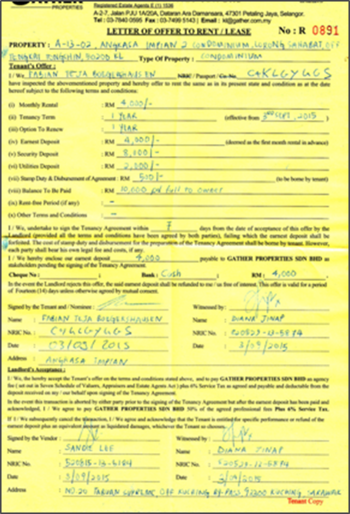
TOOLS: Utility bills/Tenancy Agreement. Address proof
Utility bills (for last 3 months)
Coverage – all apartment owners, all officially rented clients
Purpose – Proof of Address
Cost of obtaining the fake – no special protection
Features – date of issuance
Availability – provided once a month, could be printed from branch, could be printed from providers site
Easy available, could be cross-checked vs NRIC, vs Credit Report, vs Bank statement
Tenancy Agreement (minimum 1.5 month before termination)
Coverage – all officially rented
Purpose – Proof of Address
Cost of obtaining the fake – no special protection
Features – Landlord contacts
Availability – stored at customer’s place of living
Easy available, could be verified by contacting the Landlord
Notes:
Дописать про MLAS

Slide 40
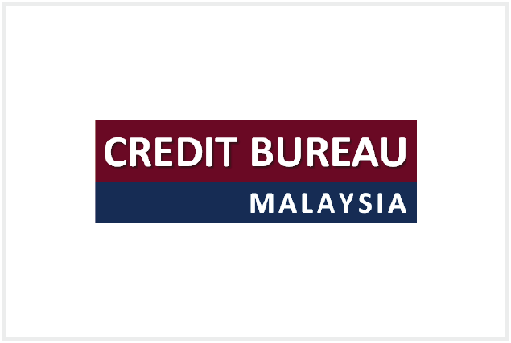


TOOLS: Credit Bureaus. Credit History Check
Credit Bureau | Report Cost | Online integration | Numbers of Records | Number of subscribers | WEB
CTOS | 2,1 usd | Yes | 15 mln records | +++ | http://www.ctoscredit.com.my/
RAM | 2 usd | Yes | 13 mln records | ++ | http://www.ramcreditinfo.com.my/
Credit bureau of Malaysia | 1,5 usd | No | 9 mln records | + | https://www.creditbureau.com.my/
FIS | 1 usd | Yes | 9 mln records | + | http://www.fis.com.my
Credit Bureau | Credit history | Utility Bills* | Business ownership | Dishonored checks | Cooperatives loans | Rating
CTOS | Yes | Yes | Yes | Yes | Yes
RAM | Yes | Yes | Yes | Yes | No
Credit bureau of Malaysia | Yes | No | Yes | Yes | No
FIS | Yes | No | Yes | Yes | No
We will work with CTOS due to wide coverage of data and high number of subscribers including cooperatives and ML
* electricity, water, telecom
** Shareholder, Directorship

Slide 41
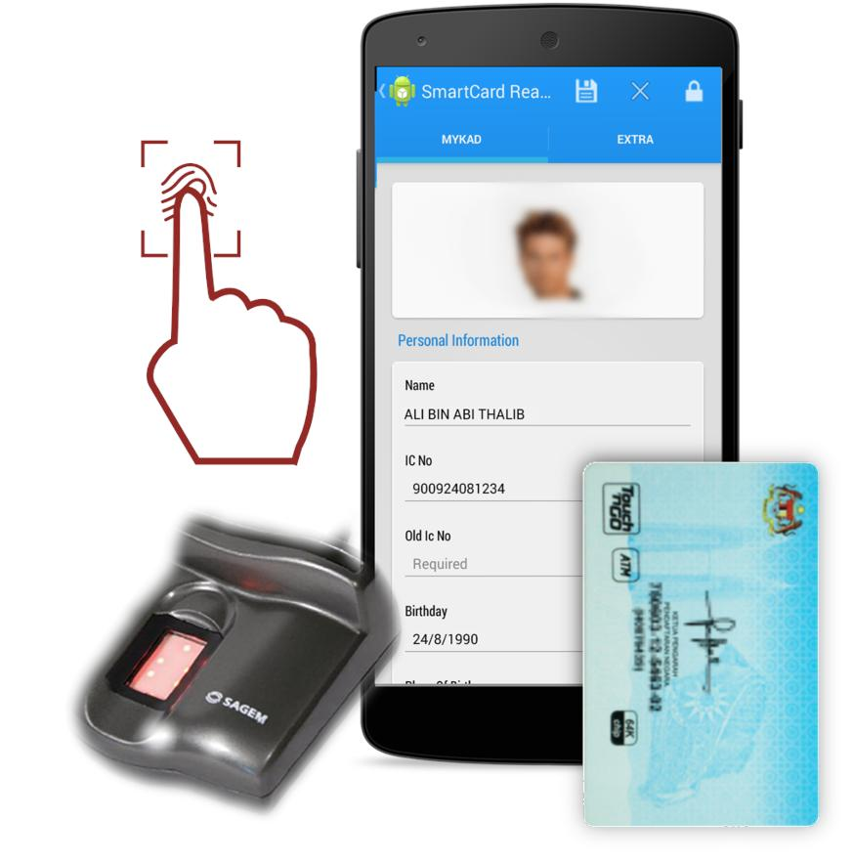
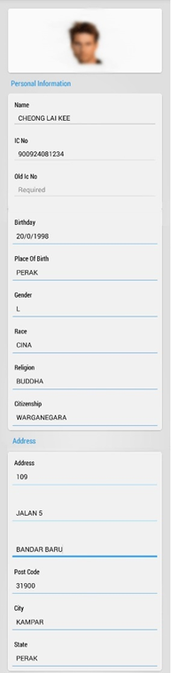
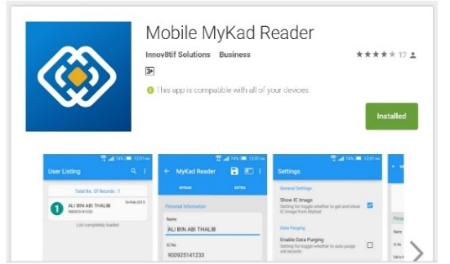
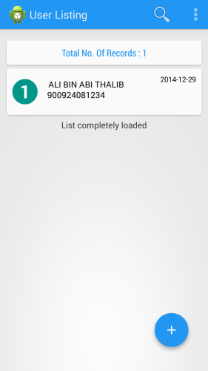
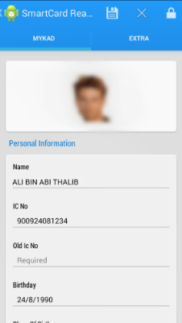
TOOLS: Biometric Scanner. Identification
Description:
Malaysian IDs (NRIC) comes with a readable microchip that can be read and verified by using the Mobile Biometric Scanner (MBS).
MBS are widely used by all the Banks all over the country
MBS are small, portable and easy to carry in the bag
Integration:
The MBS App must be downloaded into the Courier’s mobile phone
Biometric Scanner will be connected to Smart Phone via cable connection
Process:
Insert NRIC into MBS Slot
If NRIC can’t be read - Request Customer to change a new NRIC
Customer places thumb (from any hand) to the MBS
Upon successful verification of thumb print, full details of NRIC will be displayed on the Smart Phone and ready to be sent to Data Centre/Email;
If verification failed, NRIC might be fake or it does not belongs to the customer.
NRIC Information
Photo
Name
IC
Birthday
Place of birth
Gender
Race
Religion
Citizenship
Address
Post code
City
State
MBS Information
Date of issue
E.M origin, Handcode

Slide 42
Decision Making Procedure
# | Check | On-line with courier | Full on-line
1 | Auto Stop-factors | Age, employment, resident, income
2 | Black list and databases | Internal black list
3 | Credit rules | Different logic rules, depending on credit history, max. loan amount calculation, etc.
4 | Local credit bureau information | CTOS
5 | Scoring | Internet (outsourced), social-demographic
6 | Visual stop factors | During the meeting with courier | ID Card/Other documents
7 | Documents and data checking | ID scanner for reading ID chip | Visual checking ID
8 | Phone verification | Checking information provided by potential customer, check for obvious signs of fraud
Documents requirement | Applicable Documents
ID | NRIC
Proof of income | EPF statement OR Bank Statements (3 months)
Proof of residence | Utility bills (3 months) OR Tenancy Agreement (min 3 months validity)
Average decisioning time will be within 60 minutes
Notes:
Дописать про MLAS

Slide 43
Collections Procedure – Target Model
# | Stage | Short Description | Stage Period | Resorces
0 | Pre – Collection | SMS Notification borrower about payment In case social default we offer loan restructuring for fee | - 7 - 0 days before payback | In-house
1 | Soft Collection | Direct Debit from the clients account Telemarketing*, SMS and Email– Notification about missed payment. In case social default we offer loan restructuring for fee | 1-6 days after default | In-house
3 | Hard Collection | Field visit** to living area, work, borrower’s relatives home. | 7+ days after default | In-house
5 | Litigation / Execution | We will hire Legal council with the court cases practice | 90+ | In-house
6 | Debt Sale | After 120 Days of default we will sell debt | 120+ | Outsourced
All conversations with customer will be recorded
** Will be recorded

Slide 44
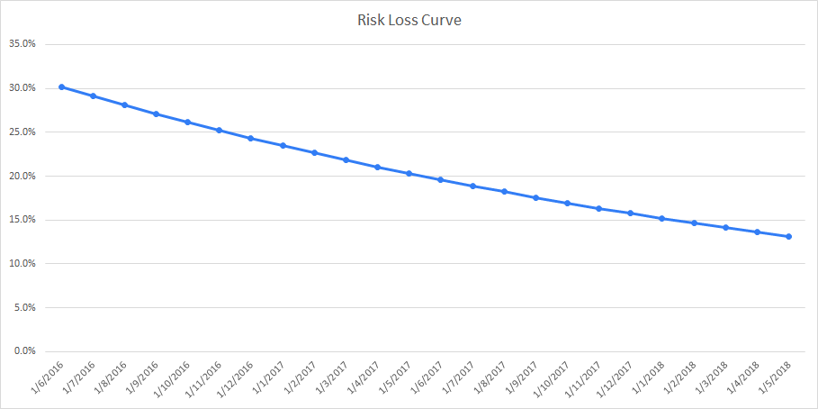
Risk Loss curve
Implemented New Anti Fraud rules
Using web history data
Internal score card with a 2 year maturity of client’s payment details identified
Start with the Credit rules, Phone verifications, Credit bureaus, Data and documents checking
Customer’s short term repayment pattern identified
Customer’s long term repayment behavior identified
Unsatisfactory customers identified and filtered out
Implement the first internal score card updated monthly
Duration (Months)
We will achieve the target risk percentage of 13% from disbursement volume at the end of the 3rd year as a result of implementing new “big data” sources and developing scoring power

Slide 45
6. IT
Notes:
Ответить Сергею Минакову
Вопрос Минакову – какие сервисы будут использоваться – что имеется в виду?

Slide 46
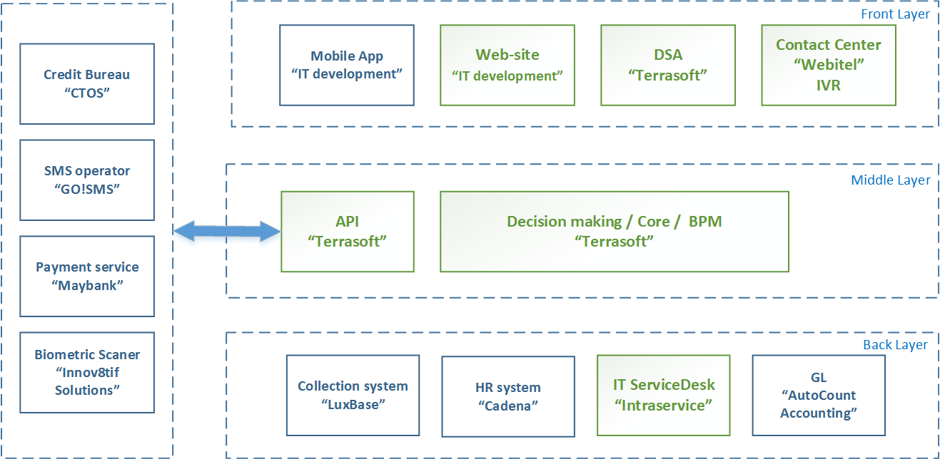
IT architecture

Slide 47
IT Scope Of Work
# | Integration partner | Type of the partner | Comments
1 | AutoCount Accounting http://www.autocountsoft.com/ | GL system supplier | Accounting software supplier
2 | CTOS http://www.ctoscredit.com.my/ | Credit bureau | Provides the credit report services
3 | Maybank http://www.maybank2u.com.my/ | Disbursement Partner | Main bank in Malaysia, permit makes integration
4 | GO!SMS http://www.gosms.com.my/ | SMS Partner | Leading Bulk SMS reminder service. Permits integration.
5 | Innov8tif Solutions http://www.innov8tif.com/ | Biometric Scanner Partner | Leading Biometric Scanner Provider. Permits Integration
# | New functionality | The essence
1 | Customer notification | Integration with local SMS agent for customer information
2 | Local GL system | Required for reporting to government yearly
3 | Connection to My Credit Bureau | Use CTOS and RAM Link to get access to credit bureau before incorporation
4 | Online antifraud | Enable to detect and decrease fraud in online applications

Slide 48
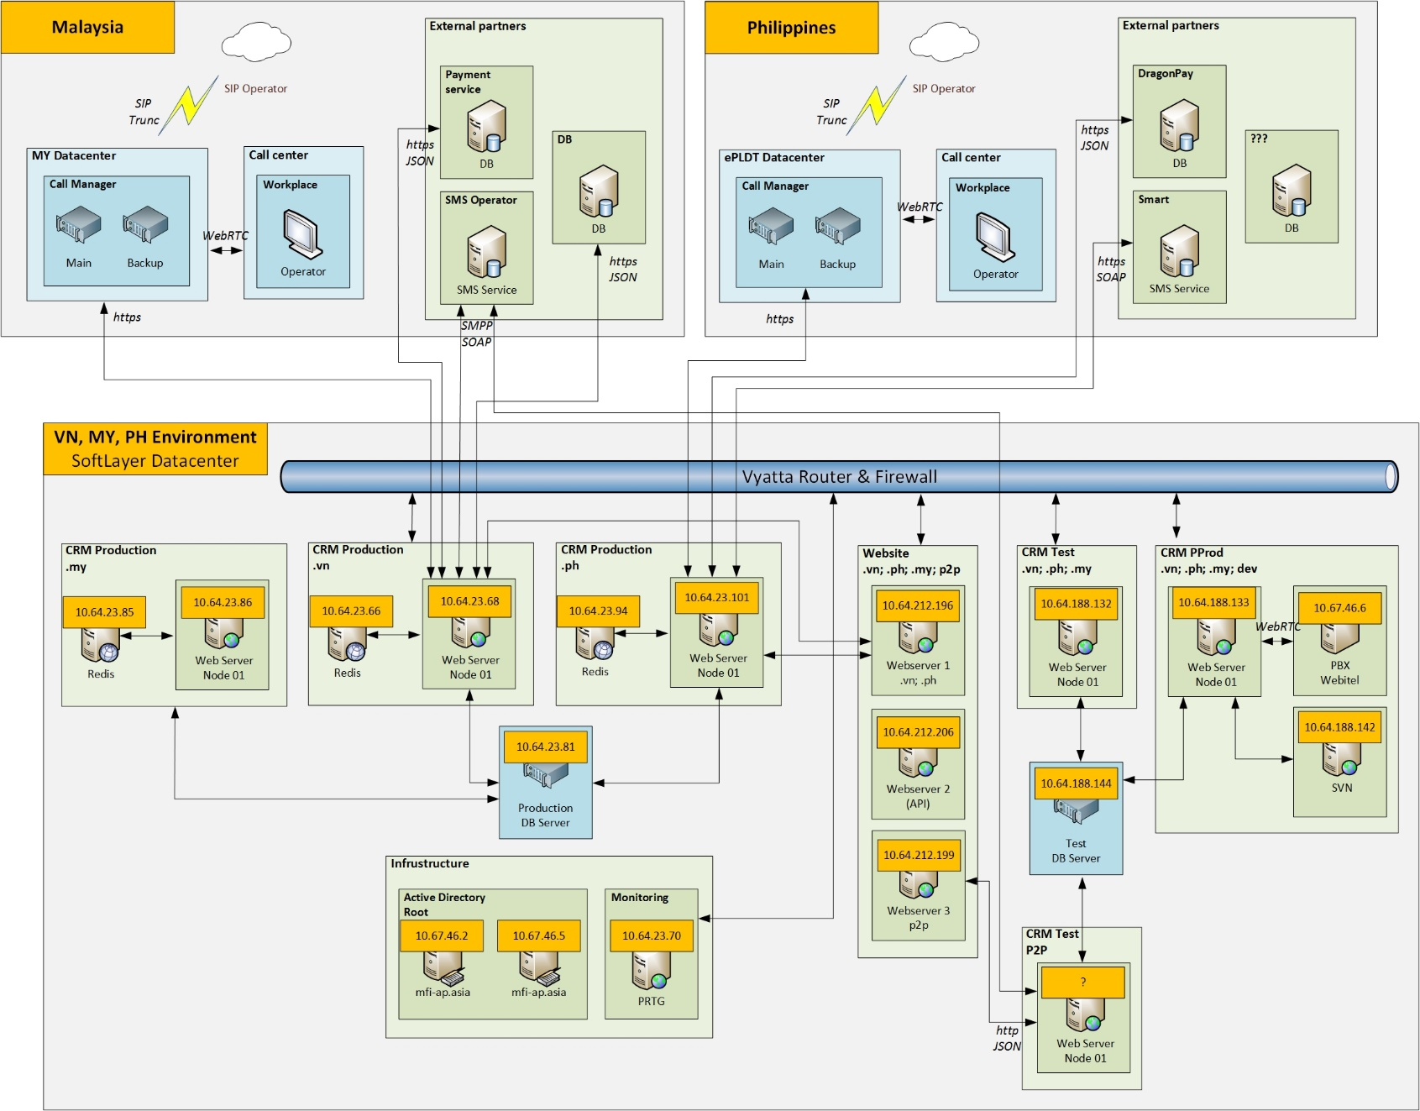
IT architecture geo layout

Slide 49
7. HR & Admin Information

Slide 50
Organizational Chart for ML 2020

Slide 51
Organizational Chart for RMC

Slide 52
8. Finance

Slide 53
Assumptions and sensitivity analysis
Main Loan parameters
Loan type | Average loan size, USD | Average term | Early repayments | 1st prolongation | 2nd prolongation | Conversion to next tier | Roll-rate 0->1 | Roll-rate 1->2 | Roll rate 2->3+ | Total losses (with prolongations)
Tier 1 loans | 400 | 25 days | 10% | 33% | 11% | 65% | 30% | 70% | 80% | 13,2%
Tier 2 loans | 520 | 25 days | 10% | 33% | 11% | 65% | 20% | 70% | 80% | 8,8%
Tier 3 loans | 680 | 25 days | 10% | 33% | 11% | 65% | 20% | 70% | 80% | 8,8%
Income and expenses parameters
Loan type | Normal interest rate, per day | Late penalty interest rate, per day | Disbursement fee received | Prolongation fee received, | Marketing acquisition cost, USD
PDL Loans | 1,00% | 1,00% | 0,0% | 0,0% | 24
Sensitivity analysis
Sensitivity to number of clients | 70% | 80% | 90% | 100% | 110% | 120% | 130% |  | Sensitivity to PDL size | 70% | 80% | 90% | 100% | 110% | 120% | 130%
5 years Profit after taxes | 9 878 | 12 533 | 15 188 | 17 840 | 20 485 | 23 137 | 25 806 |  | 5 years Profit after taxes | 6 594 | 10 346 | 14 094 | 17 840 | 21 585 | 25 327 | 29 069
5 years average yearly ROE | 32% | 39% | 45% | 51% | 57% | 62% | 67% |  | 5 years average yearly ROE | 19% | 30% | 41% | 51% | 61% | 71% | 80%
Sensitivity to prolongation rates | 70% | 80% | 90% | 100% | 110% | 120% | 130% |  | Sensitivity to conversion rates | 70% | 80% | 90% | 100% | 110% | 120% | 130%
5 years Profit after taxes | 16 432 | 16 902 | 17 367 | 17 840 | 18 300 | 18 773 | 19 251 |  | 5 years Profit after taxes | 10 027 | 12 294 | 14 868 | 17 840 | 21 260 | 25 175 | 29 710
5 years average yearly ROE | 48% | 49% | 50% | 51% | 52% | 54% | 55% |  | 5 years average yearly ROE | 30% | 36% | 43% | 51% | 60% | 70% | 82%
Sensitivity to NPL level | 70% | 80% | 90% | 100% | 110% | 120% | 130% |  | Sensitivity to marketing costs | 70% | 80% | 90% | 100% | 110% | 120% | 130%
5 years Profit after taxes | 18 842 | 18 505 | 18 172 | 17 840 | 17 507 | 17 174 | 16 845 |  | 5 years Profit after taxes | 19 997 | 19 278 | 18 559 | 17 840 | 17 121 | 16 402 | 15 683
5 years average yearly ROE | 55% | 54% | 53% | 51% | 50% | 49% | 47% |  | 5 years average yearly ROE | 60% | 57% | 54% | 51% | 48% | 46% | 43%

Slide 54
Investment summary
Investment summary |  |  | Timeline
thsd USD | Year 1 | Year 2 | Year 3 | Year 4 | Year 5* | Total
investments | 4 639 | 3 674 | 249 | 0 | 0 | 8 563
Total investments | 4 639 | 3 674 | 249 | 0 | 0 | 8 563
Number of loans issued (thsd) | 9 | 47 | 89 | 141 | 198 | 483
Amount disbursed | 3 661 | 20 510 | 41 989 | 68 739 | 98 463 | 233 361
Net portfolio (EoY) | 1 160 | 3 529 | 6 114 | 9 813 | 13 503 | 13 503
Revenue | 700 | 7 059 | 15 496 | 25 452 | 37 314 | 86 021
G&A ** | -1 971 | -2 664 | -2 439 | -2 679 | -2 998 | -12 752
One-off expenses *** | -567 | 0 | 0 | 0 | 0 | -567
Net profit after taxes | -2 907 | -1 171 | 3 705 | 6 774 | 11 440 | 17 840
ROE (yearly) | -113% | -17% | 41% | 75% | 126% | 51%
ROAA (yearly) | -261% | -34% | 60% | 69% | 81% | 42%
* - normalized year with no new clients growth
** - See slide 56 for details
*** - See slide 57 for details
Break-even period – 18 months.
Payback period – 51 months.
Maximum investments from – $8,6M.

Slide 55
Balance sheet
Balance Sheet (EOY) |  |  | Timeline
thsd USD | Year 1 | Year 2 | Year 3 | Year 4 | Year 5
Assets | 2 231 | 4 734 | 7 642 | 11 977 | 16 210
Liquid assets | 463 | 629 | 924 | 1 514 | 2 079
Loans to individuals (net of provisions) | 1 288 | 3 625 | 6 238 | 9 983 | 13 651
PDL | 2 167 | 7 981 | 15 407 | 26 705 | 41 074
Risk provisions - PDL | -879 | -4 356 | -9 170 | -16 722 | -27 423
Noncurrent assets | 480 | 480 | 480 | 480 | 480
Liabilities | 1 616 | 3 655 | 3 904 | 3 904 | 3 904
Loans | 1 616 | 3 655 | 3 904 | 3 904 | 3 904
Shareholders' equity | 614 | 1 079 | 3 738 | 8 073 | 12 306
Contributed equity | 3 522 | 5 157 | 5 157 | 5 157 | 5 157
Retained earnings | -2 907 | -4 078 | -1 419 | 2 916 | 7 149

Slide 56
P&L Statement
P&L |  |  | Timeline
thsd USD | Year 1 | Year 2 | Year 3 | Year 4 | Year 5 | Total
Revenue | 700 | 7 059 | 15 496 | 25 452 | 37 314 | 86 021
Risk provisions | -879 | -3 477 | -4 814 | -7 552 | -10 701 | -27 423
% of revenue | -126% | -49% | -31% | -30% | -29% | -32%
Acquisition costs - marketing | -205 | -1 009 | -1 915 | -3 043 | -4 273 | -10 444
% of revenue | -29% | -14% | -12% | -12% | -11% | -12%
Acquisition costs - other | -174 | -680 | -1 244 | -1 961 | -2 667 | -6 726
% of revenue | -25% | -10% | -8% | -8% | -7% | -8%
Support costs | -42 | -221 | -355 | -509 | -692 | -1 819
% of revenue | -6% | -3% | -2% | -2% | -2% | -2%
VAT | 0 | -61 | -213 | -382 | -594 | -1 251
Operating profit (before fixed costs) | -600 | 1 611 | 6 954 | 12 006 | 18 386 | 38 358
% of revenue | -86% | 23% | 45% | 47% | 49% | 45%
G&A | -1 971 | -2 664 | -2 439 | -2 679 | -2 998 | -12 752
% of revenue | -282% | -38% | -16% | -11% | -8% | -15%
One-off expenses | -260 | 0 | 0 | 0 | 0 | -260
Depreciation and amortization | -73 | -100 | -100 | -100 | -100 | -472
Profit before Taxes | -2 905 | -1 152 | 4 416 | 9 226 | 15 288 | 24 874
% of revenue | -415% | -16% | 28% | 36% | 41% | 29%
Income tax | -2 | -19 | -711 | -2 453 | -3 849 | -7 034
Profit after Taxes | -2 907 | -1 171 | 3 705 | 6 774 | 11 440 | 17 840
% of revenue | -416% | -17% | 24% | 27% | 31% | 21%

Slide 57
Cash flow statement
Cash flow statement |  |  | Timeline
thsd USD | Year 1 | Year 2 | Year 3 | Year 4 | Year 5 | Total
Cash flow from operations | -1 695 | 2 406 | 8 619 | 14 426 | 22 240 | 45 996
Income | 700 | 7 059 | 15 496 | 25 452 | 37 314 | 86 021
Acquisition costs | -379 | -1 688 | -3 159 | -5 004 | -6 940 | -17 170
Support costs | -42 | -221 | -355 | -509 | -692 | -1 819
G&A | -1 971 | -2 664 | -2 439 | -2 679 | -2 998 | -12 752
VAT | 0 | -61 | -213 | -382 | -594 | -1 251
CIT | -2 | -19 | -711 | -2 453 | -3 849 | -7 034
Cash flow from investing | -2 734 | -5 814 | -7 427 | -11 298 | -14 369 | -41 641
PDL Loans disbursed | -4 765 | -28 678 | -59 363 | -97 537 | -140 373 | -330 715
PDL Loans repaid | 2 599 | 22 864 | 51 936 | 86 239 | 126 004 | 289 641
Fixed assets & software | -567 | 0 | 0 | 0 | 0 | -567
Cash flow from financing | 4 639 | 3 674 | -797 | -2 439 | -7 207 | -2 129
Contributed equity | 3 023 | 1 635 | 0 | 0 | 0 | 4 659
Loans | 1 616 | 2 039 | 249 | 0 | 0 | 3 904
External debt financing | 0 | 0 | 0 | 0 | 0 | 0
Dividends paid | 0 | 0 | -1 046 | -2 439 | -7 207 | -10 692
Cash flow total | 211 | 266 | 395 | 689 | 664 | 2 226

Slide 58
G&A
G&A, thsd USD |  |  | Timeline
Expenses category | 2016 | 2017 | 2018 | 2019 | 2020 | Total
Salary | 1 172 | 1 998 | 1 858 | 2 099 | 2 417 | 9 544
Rent | 137 | 172 | 191 | 191 | 191 | 882
Marketing & PR | 78 | 94 | 94 | 94 | 94 | 456
IT | 189 | 147 | 147 | 147 | 147 | 775
Legal | 50 | 0 | 0 | 0 | 0 | 50
Travel | 35 | 42 | 42 | 42 | 42 | 203
Contingency | 310 | 211 | 107 | 107 | 107 | 842
Total | 1 971 | 2 664 | 2 439 | 2 679 | 2 998 | 12 752

Slide 59
One-off budget
Yury
Expenses category | Total |  | Type
Licensing | 110
ML License acquisition (transaction expenses) | 100 |  | Written-off to expenses
Company registration expenses | 10 |  | Written-off to expenses
Offices | 174 |  | Capitalized
IT | 167
Terrasoft adaptation & translation | 70 |  | Capitalized
ML Web Site development | 10 |  | Capitalized
Contact center licenses | 15 |  | Capitalized
Contact center implementation | 7 |  | Written-off to expenses
Mobile application development | 15 |  | Capitalized
Social network scoring development | 5 |  | Capitalized
Push notification system | 15 |  | Capitalized
Initial payment to payment provider(deposit) | 5 |  | Written-off to expenses
Marketing Analytics Solution | 12 |  | Capitalized
Local General Ledger license | 3 |  | Capitalized
Local General Ledger implementation | 10 |  | Written-off to expenses
Recruiting | 60 |  | Written-off to expenses
Brand registration | 55 |  | Capitalized
CAPEX total | 567

Slide 60
9. Project Risks & Mitigation

Slide 61
Main Identified Risks & Their Mitigation 1/2
# | Risk type | Risk | Mitigation tool
1 | Target license | Long period of getting license License reject | Using lobby resource Buying existing ML license Rent the license (Creative scheme)
2 | Target business model | Interest rate cap excess Electronic signature for repeat loans | Fees payable by law Fees that is payable by the moneylenders to a 3rd party whilst processing the loan application including risk consultation. Electronic Commerce Act 2006 allows “electronic signature” means any letter, character, number, sound or any other symbol or any combination thereof created in an electronic form adopted by a person as a signature”
3 | Operational | Invalid and/or incorrect personal data in online application (on web site or in CRM) | Built-in auto online checks and Credit Bureau Checks Obligatory mobile number SMS-verification procedure
 |  | Lose customers application data | Saving all signature in CRM and creating back up everyday
 |  | Technical bugs during process | Tests carried out on a weekly by staff and IT department
Notes:
При низком показателе проникновения кредитных продуктов, основная их часть сосредоточена в сегменте SEC A и SEC B, при высоких требованиях к заемщику. Стратегия DCFC – всегда доступная финансовая поддержка рядом с клиентом посзволяет ориентироваться на 70% рынка.

Slide 62
Main Identified Risks & Their Mitigation 2/2
# | Risk type | Risk | Mitigation tool
5 | Fraudulent | Fake ID using for application | Courier with biometric scanner will verify ID
 |  | Using robots for mass application filtering | Obligatory mobile number SMS-verification Using Facebook verification Developing mobile app for better verification and scoring
 |  | Fraudsters attack | Automated black lists check (lists are both internal and external) and Phone verification Low initial loan amount (to minimize losses) Taking into consideration place of signing contract and desirable way of money transfer (will be taken into consideration by automatic scoring) Analyzing IP address and cookies during web application(to identify and reduce high risk)
 |  | Customers will apply for 2nd loan to close 1st loan | Frozen possibility to apply 2nd loan during first loan existence
 |  | Telemarketing and verification staff will be in cahoots with borrowers | New employees’ obligatory check for criminal records Analyzing performance of each person Cross-check and randomizing areas (districts of country) which staff cover in operations
6 | Collections | Customers unavailability in case of delinquency | Mandatory request of providing contact person’s mobile number in application in case of collections necessity Providing work and home phone numbers Application with GPS tracking setting up to customer’s phone
 |  | Denying loan receipt in case of not repaying | Taking thumbprint during signing the agreement
 |  | Customer mention that loan repayment process fail | Get confirmation from customer to show proof that this is the case.
Notes:
При низком показателе проникновения кредитных продуктов, основная их часть сосредоточена в сегменте SEC A и SEC B, при высоких требованиях к заемщику. Стратегия DCFC – всегда доступная финансовая поддержка рядом с клиентом посзволяет ориентироваться на 70% рынка.

Slide 63
10. Project Plan

Slide 64

Project Plan
Activity | Planning end date | Comments
Hiring CEO | November 2015 | Found and approved by Headquarters
Licensing | January 2016 – March 2016 | Filling documents for regulator
Online Advertising permit | April 2016 | After getting the license
Renting offices | January 2016 – February 2016 | Signing contract
Creating team | January 2016 – April 2016 | We have regular candidates screening
IT settings, product settings | March 2016 – April 2016 | We have identified all key partners
Official documents | February 2015 - April 2016 | Documentation preparation for customers and regulator
Start sales | 29 April 2016
Activity | Jan-16 | Feb-16 | Mar-16 | Apr-16 | May-16
Licensing
Online Advertising permit
Renting office: ML, RMC
Creating team
IT Development, product settings
Official documents for customers and regulator
Start operations
We are planning to launch operations in May 2016.

Slide 65
11. Appendices

Slide 66
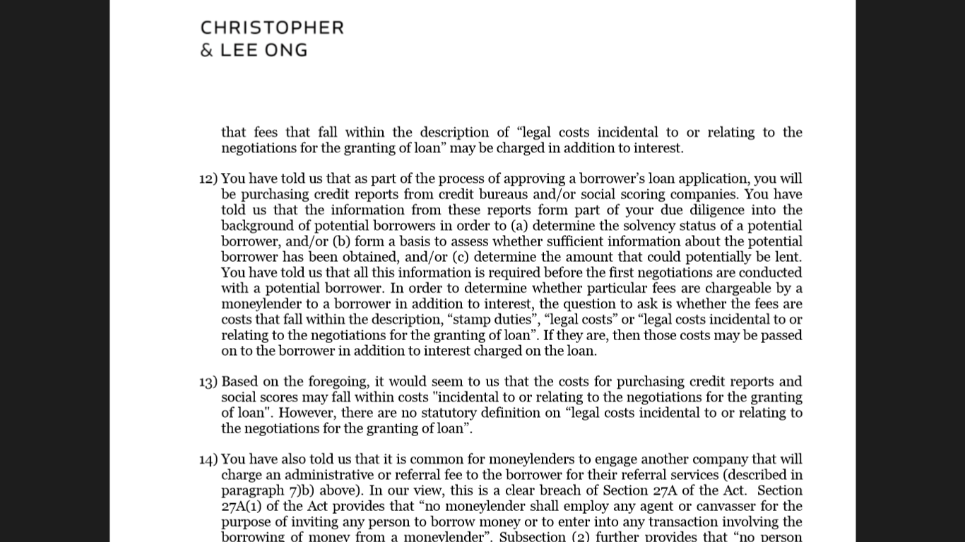
Christopher and Lee Ong Legal Opinion
Notes:
Ответ от Rajah & Tan

Slide 67


Legal Process Of Charging
Example based on Ave Loan amount
Request payment for credit report by credit bureaus (2.1 USD)
Сredit bureau
Client applies and confirm fees and requests:
2.5 USD – Stamp duty fee
2.1 USD – Credit Bureau
2.5 USD – Attestation fee
80 USD - Due Diligence fee
Moneylender
Providing credit report about potential borrower by credit bureaus (on behalf of the customer)
Due Diligence fee – 80 USD (20% from Loan amount)
Sign loan agreement for 400 USD
Transferring loan (400 USD – 87.1 USD = 312.9 USD)
Creation Due Diligence report about client (on behalf of the customer)
ML will be paying a third party (the “Risk Management Company") to conduct a background check on potential borrowers specifically focusing on potential borrowers' online presence, and based on information obtained on potential borrowers, to verify details such as address, IC details and passport details. A CONSENT form (in accordance to the PDPA Act will be signed by the Borrower to allow ML to do the checks.
Risk Management Company (our company)
Type | Size | Payable to
Stamp duty fee | 2.5 USD | Inland Revenue Board
Legal costs
Credit Bureau report | 2.1 USD | CTOS
Attestation fee | 2.5 USD | External Lawyer
Due Diligence fee | 80 USD (20% from Loan amount) | Risk Management Company (our company)
Product parameters
Average loan size – 400 USD
Maximum loan tenure – 1 month. If client wants to use loan longer time, after one month he should get one more loan and make repayment for the initial loan

Slide 68
Interest Cap & Loan Agreement. Legal opinion
Restriction | Question | Answer | Risk
Interest cap «For the purposes of this Act, the interest for an unsecured loan shall not exceed eighteen per centum per annum»* | How we can charge any fees? | Fees chargeable legally and by law IN ADDITION to the interest rate (18% per annum) are as follows: Stamp Duty Legal Costs (Lawyer and legal fees, etc.) Fees payable by law | No risks as legal costs incidental to and relating to negotiations for granting the loan are allowed in the Moneylenders Act and it does not have any statutory definition.
Loan agreement «“moneylending agreement” means an agreement made in writing between a moneylender and a borrower for the repayment, in lump sum or instalments, of money borrowed by the borrower from the moneylender»** | Can we use remote model? | For first loan applications, OFFLINE process is advised (In the office or by Couriers). As signing and attestation will have to be done face to face (as suggested by our panel lawyer) | No risks
 | How we can granting second loan online? | As agreements are signed OFFLINE for the first time of granting the loan, second loan onwards can be done online as written in the agreement between ML and Customer. | Potential low risk
* Source of information: 17A - Act 400 - MONEYLENDERS ACT 1951
** Source of information: 2 - Act 400 - MONEYLENDERS ACT 1951

Slide 69
Attestations Of Agreements. Legal opinion
Restriction | Question | Answer | Risk
Attesting. «A moneylending agreement shall be attested by an Advocate and Solicitor of the High Court, an officer of the Judicial and Legal Service, a Commissioner for Oaths, District Officer, Justice of the Peace or such other person as may be appointed by the Minister generally for such purpose»* | Who can we attest the loan agreement? | Attestation of loan agreements can be done by our own In-House Legal Employee (Certified Lawyer) | No risk
 | Could Attesting be done remotely? | Attestation of loan agreements can be done by SKYPE & VIDEO CALLS | Low Risk. According to ML Act there is no requirements for the place of Attestation
* Source of information: 27(1) - Act 400 - MONEYLENDERS ACT 1951

Slide 70
Collection. Legal opinion
Restriction | Question | Answer | Risk
Late payment fee not exceeding 8% per annum | Can take additional to allowed by ML Act Late Payment Fee: Calculated at the rate of 8 per centum per annum from day to day from the date of default in payment of the sum or instalment until that sum or instalment is paid | In any case of bad debts, these cases can be assigned to Third Party Debt Collection agencies. We will take commission payable to independent company (our Risk Management Company) which will charge an additional of 1% of the overdue amount per day as Debt Collection & Consultation fees. | Low Risk
* Source of information: 17- Act 400 - MONEYLENDERS ACT 1951

